Slide 1
MIT 6.875 & Berkeley CS276
Foundations of Cryptography
Lecture 16

Slide 2
Today: Non-Interactive Zero-Knowledge (NIZK)
In Two Days: An Application of NIZK

Slide 3
NP Proofs
For the NP-complete problem of graph 3-coloring
Proof =
Verifier V checks: (a) only 3 colors are used & (b) any two vertices connected by an edge are colored differently.
Prover P has a witness, the 3-coloring of G

Slide 4
Zero-Knowledge (Interactive) Proof
Because NP proofs reveal too much
Commitments
$$e←E$$

Slide 5
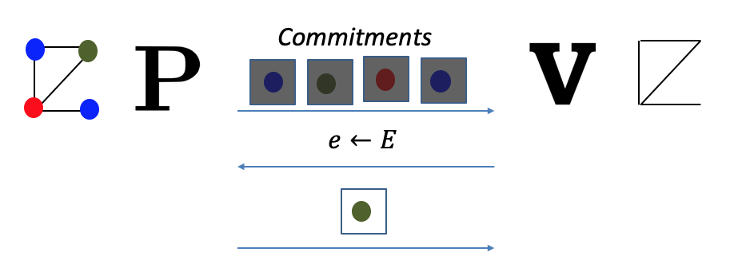
Zero-Knowledge (Interactive) Proof
Because NP proofs reveal too much
1. Completeness: For every $G∈$3COL, V accepts P’s proof.
2. Soundness: For every $G∉$3COL and any cheating $P^{∗}$, V rejects $P^{∗}$’s proof with probability $≥1−neg(n)$
3. Zero Knowledge: For every cheating $V^{∗},$there is a PPT simulator S such that for every $G∈$ 3COL, S simulates the view of $V^{∗}$.

Slide 6
TODAY:
Can we make proofs non-interactive again?
Why?
V does not need to be online during the proof process.
Proofs are not ephemeral, can stay into the future.

Slide 7
TODAY:
Can we make proofs non-interactive again?
NO!
YES, WE CAN!

Slide 8
Non-Interactive ZK is Impossible
Suppose there were an NIZK proof system for 3COL.
Graph G
Graph G
$$π$$
Step 1. When G is in 3COL, V accepts the proof $π$.
(Completeness)

Slide 9
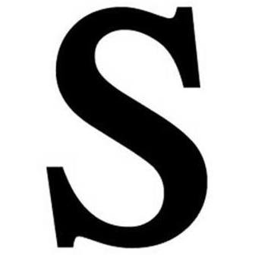
Non-Interactive ZK is Impossible
Suppose there were an NIZK proof system for 3COL.
Graph G
Graph G
$$\tilde{π }$$
Step 2. PPT Simulator S, given only G in 3COL, produces an indistinguishable proof $\tilde{π}$ (Zero Knowledge).
In particular, V accepts $\tilde{π}$.

Slide 10
Non-Interactive ZK is Impossible
Suppose there were an NIZK proof system for 3COL.
Graph G
Graph G
$$\tilde{π }$$
Step 3. Imagine running the Simulator S on a $G∉$3COL. It produces a proof $\tilde{π}$ which the verifier still accepts!
(WHY?! Because S and V are PPT. They together cannot tell if the input graph is 3COL or not)

Slide 11
Non-Interactive ZK is Impossible
Suppose there were an NIZK proof system for 3COL.
Graph G
Graph G
$$π$$
Step 4. Therefore, S is a cheating prover!
Produces a proof for a $G∉$3COL that the verifier nevertheless accepts.
Ergo, the proof system is NOT SOUND!

Slide 12
THE END
Or, is it?

Slide 13
Enter: The Common Random String
CRS
010111000101010010
Graph G
Graph G
$$π$$

Slide 14
Enter: The Common Reference String
$$CRS←D$$
(e.g., CRS = product of two primes)
Graph G
Graph G
$$π$$

Slide 15
NIZK in the CRS Model
CRS
010111000101010010
Graph G
Graph G
$$π$$
1. Completeness: For every $G∈$3COL, V accepts P’s proof.
2. Soundness: For every $G∉$3COL and any “proof” $π^{∗}$, ${V(CRS,π}^{∗})$ accepts with probability $≤neg(n)$

Slide 16
NIZK in the CRS Model
CRS
010111000101010010
Graph G
Graph G
$$π$$
3. Zero Knowledge: There is a PPT simulator S such that for every $G∈$ 3COL, S simulates the view of the verifier V.
$S(G)≈(CRS←D,$ $π←P(G,colors))$

Slide 17
NIZK in the CRS Model
CRS
010111000101010010
Graph G
Graph G
$$π$$
3. Zero Knowledge: There is a PPT simulator S such that for every $x∈L$ and witness $w$, S simulates the view of the verifier V.
$S(x)≈(CRS←D,$ $π←P(x,w))$

Slide 18
HOW TO CONSTRUCT NIZK IN THE CRS MODEL
1. Blum-Feldman-Micali’88 (quadratic residuosity)
1. Blum-Feldman-Micali’88 (quadratic residuosity)
2. Feige-Lapidot-Shamir’90 (factoring)
3. Groth-Ostrovsky-Sahai’06 (bilinear maps)
4. Canetti-Chen-Holmgren-Lombardi-Rothblu$m^{2}$-Wichs’19
and Peikert-Shiehian’19 (learning with errors)

Slide 19
HOW TO CONSTRUCT NIZK IN THE CRS MODEL
Step 1. Review our number theory hammers & polish them.
Step 2. Construct NIZK for a special NP language, namely quadratic non-residuosity.
Step 3. Bootstrap to NIZK for 3SAT, an NP-complete language.

Slide 20
Quadratic Residuosity
Let $N=pq$ be a product of two large primes.
$$Z_{N}^{∗}$$
$${Jac}_{−1}$$
$${Jac}_{+1}$$
$$\{x:\left({x \atop N}\right)=−1\}$$
$$\{x:\left({x \atop N}\right)=+1\}$$

Slide 21
Quadratic Residuosity
Let $N=pq$ be a product of two large primes.
$$Z_{N}^{∗}$$
$${Jac}_{−1}$$
$${Jac}_{+1}$$
$$\{x:\left({x \atop N}\right)=−1\}$$
$$\{x:\left({x \atop N}\right)=+1\}$$
$Jac$ divides $Z_{N}^{∗}$ evenly unless N is a perfect square.

Slide 22
Quadratic Residuosity
Let $N=pq$ be a product of two large primes.
$$Z_{N}^{∗}$$
$${Jac}_{−1}$$
$${Jac}_{+1}$$
$$\{x:\left({x \atop N}\right)=−1\}$$
$$\{x:\left({x \atop N}\right)=+1\}$$
Surprising fact: Jacobi symbol $\left({x \atop N}\right)$ = $\left({x \atop p}\right)$ $\left({x \atop q}\right)$ is computable in poly time without knowing $p$ and $q$.

Slide 23
Quadratic Residuosity
Let $N=pq$ be a product of two large primes.
$${Jac}_{+1}$$
So: ${QR}_{N}= \{x:\left({x \atop p}\right)=\left({x \atop q}\right)=+1\}$
$${QR}_{N}$$
${QNR}_{N}= \{x:\left({x \atop p}\right)=\left({x \atop q}\right)=−1\}$
$${QNR}_{N}$$
${QR}_{N}$ is the set of squares mod $N$ and ${QNR}_{N}$ is the set of non-squares mod $N$ with Jacobi symbol +1.

Slide 24
Quadratic Residuosity
Exactly half residues even if $N=p^{i}q^{j},i,j≥1, not both even.$
$${Jac}_{+1}$$
$${QR}_{N}$$
$${QNR}_{N}$$
${QR}_{N}$ is the set of squares mod $N$ and ${QNR}_{N}$ is the set of non-squares mod $N$ with Jacobi symbol +1.

Slide 25
Quadratic Residuosity
Exactly half residues even if $N=p^{i}q^{j},i,j≥1, not both even.$
$${Jac}_{+1}$$
$${QR}_{N}$$
$${QNR}_{N}$$
IMPORTANT PROPERTY: If $y_{1}$ and $y_{2}$ are both in $QNR$, then their product $y_{1}y_{2}$ is in $QR$.

Slide 26
Quadratic Residuosity
The fraction of residues smaller if $N$ has three or more prime factors!
$${Jac}_{+1}$$
$${QR}_{N}$$
$${QNR}_{N}$$
IMPORTANT PROPERTY: If $y_{1}$ and $y_{2}$ are both in $QNR$, then their product $y_{1}y_{2}$ is in $QR$.

Slide 27
Quadratic Residuosity
Let $N=pq$ be a product of two large primes.
Quadratic Residuosity Assumption (QRA)
No PPT algorithm can distinguish between a random element of ${QR}_{N}$ from a random element of ${QNR}_{N}$ given only $N$.

Slide 28
HOW TO CONSTRUCT NIZK IN THE CRS MODEL
Step 1. Review our number theory hammers & polish them.
Step 2. Construct NIZK for a special NP language, namely quadratic non-residuosity.
Step 3. Bootstrap to NIZK for 3SAT, an NP-complete language.

Slide 29
NIZK for Quadratic Non-Residuosity
Define the NP language $GOOD$ with instances $(N,y)$ where
$N$ is good: has exactly two prime factors and is not a perfect square; and
$y∈{QNR}_{N}$ (that is, $y$ has Jacobi symbol +1
but is not a square mod $N$)
$$Z_{N}^{∗}$$
$${QR}_{N}$$
$${Jac}_{−1}$$
$${Jac}_{+1}$$
$${QNR}_{N}$$

Slide 30
NIZK for Quadratic Non-Residuosity
$$CRS=(r_{1},r_{2},…,r_{m})←{({Jac}_{N}^{+1})}^{m}$$
$$(N,y)$$
$$(N,y)$$
If $N$ is good and $y ∈{QNR}_{N}:$ either $r_{i}$ is in ${QR}_{N}$ or ${yr}_{i}$ is in ${QR}_{N}$
so I can compute $\sqrt{r_{i}}$ or $\sqrt{yr_{i}}$.
If not … I’ll be stuck!

Slide 31
NIZK for Quadratic Non-Residuosity
$$CRS=(r_{1},r_{2},…,r_{m})←{({Jac}_{N}^{+1})}^{m}$$
$$(N,y)$$
$$(N,y)$$
$∀i: \sqrt{r_{i}}$ OR $\sqrt{yr_{i}}$
Check:
$N$ is not a prime power,
$N$ is not a perfect square; and
I received either a mod-N square root of $r_{i}$ or ${yr}_{i}$

Slide 32
NIZK for Quadratic Non-Residuosity
$$CRS=(r_{1},r_{2},…,r_{m})←{({Jac}_{N}^{+1})}^{m}$$
$$(N,y)$$
$$(N,y)$$
$∀i: \sqrt{r_{i}}$ OR $\sqrt{yr_{i}}$
Soundness (what if $N$ has more than 2 prime factors)
No matter what $y$ is, for half the $r_{i}$, both $r_{i}$ and ${yr}_{i}$ are not quadratic residues.

Slide 33
NIZK for Quadratic Non-Residuosity
$$CRS=(r_{1},r_{2},…,r_{m})←{({Jac}_{N}^{+1})}^{m}$$
$$(N,y)$$
$$(N,y)$$
$∀i: \sqrt{r_{i}}$ OR $\sqrt{yr_{i}}$
Soundness (what if $N$ has more than 2 prime factors)
No matter what $y$ is, for half the $r_{i}$, both $r_{i}$ and ${yr}_{i}$ are not quadratic residues.

Slide 34
NIZK for Quadratic Non-Residuosity
$$CRS=(r_{1},r_{2},…,r_{m})←{({Jac}_{N}^{+1})}^{m}$$
$$(N,y)$$
$$(N,y)$$
$∀i: \sqrt{r_{i}}$ OR $\sqrt{yr_{i}}$
Soundness (what if $y$ is a residue)
Then, if $r_{i}$ happens to be a non-residue, both $r_{i}$ and ${yr}_{i}$ are not quadratic residues.

Slide 35
NIZK for Quadratic Non-Residuosity
$$CRS=(r_{1},r_{2},…,r_{m})←{({Jac}_{N}^{+1})}^{m}$$
$$(N,y)$$
$$(N,y)$$
$∀i:π_{i}= \sqrt{r_{i}}$ OR $\sqrt{yr_{i}}$
(Perfect) Zero Knowledge Simulator S:
First pick the proof $π_{i}$ to be random in $Z_{N}^{∗}$.
Then, reverse-engineer the CRS, letting $r_{i}=π_{i}^{2}$ or $r_{i}=π_{i}^{2}/y$ randomly.

Slide 36
NIZK for Quadratic Non-Residuosity
$$CRS=(r_{1},r_{2},…,r_{m})←{({Jac}_{N}^{+1})}^{m}$$
$$(N,y)$$
$$(N,y)$$
CRS depends on the instance N. Not good.
Soln: Let CRS be random numbers. Interpret them as elements of $Z_{N}^{∗}$ and both the prover and verifier filter out ${Jac}_{N}^{−1}$.

Slide 37
NEXT LECTURE
Step 1. Review our number theory hammers & polish them.
Step 2. Construct NIZK for a special NP language, namely quadratic non-residuosity.
Step 3. Bootstrap to NIZK for 3SAT, an NP-complete language.

