Slide 1
MIT 6.875 & Berkeley CS276
Foundations of Cryptography
Lecture 21

Slide 2
TODAY: Homomorphic Encryption

Slide 3


1. Secure Outsourcing
Input: x
Program: P
Enc(x)
x
Enc(P(x))
P(x)
Client
Server (the Cloud)
A Special Case: Encrypted Database Lookup
also called “private information retrieval” (next lec)

Slide 4

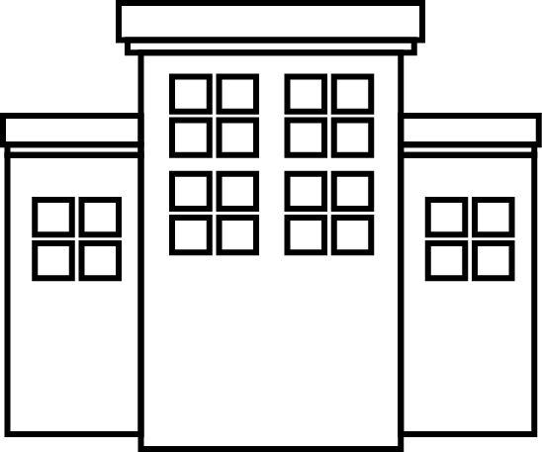
2. Secure Collaboration
(also called Secure Computation)
Hospital
ID
Genome
ID
Phenotype
“Parties learn the genotype-phenotype correlations and nothing else”

Slide 5
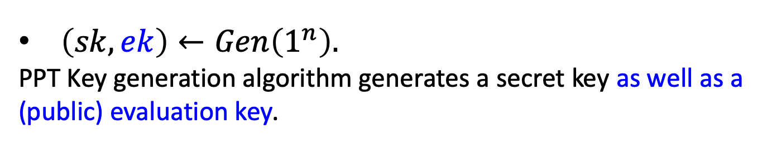
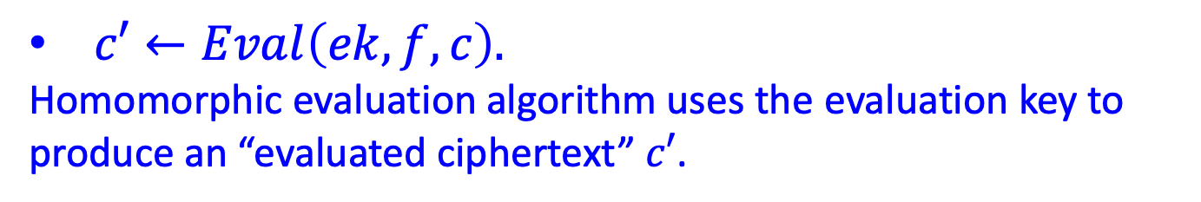
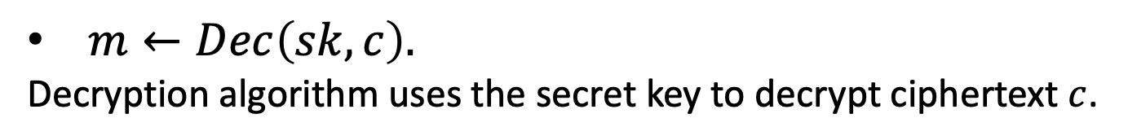
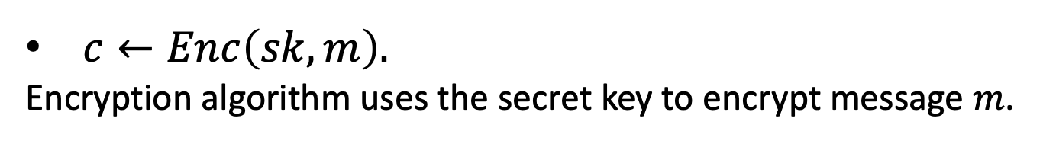
Homomorphic Encryption: Syntax
(can be either secret-key or public-key enc)
4-tuple of PPT algorithms $(Gen,Enc,Dec,Eval)$ s.t.
$\left(sk,ek\right)←Gen\left(1^{n}\right).$
PPT Key generation algorithm generates a secret key as well as a (public) evaluation key.
$c←Enc\left(sk,m\right).$
Encryption algorithm uses the secret key to encrypt message $m$.
$c′←Eval\left(ek,f,c\right).$
Homomorphic evaluation algorithm uses the evaluation key to produce an “evaluated ciphertext” $c′$.
$m←Dec\left(sk,c\right).$
Decryption algorithm uses the secret key to decrypt ciphertext $c$.

Slide 6
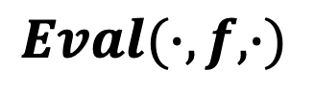




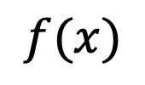


Homomorphic Encryption: Correctness
$Dec(sk,Eval\left(ek,f,Enc(x))\right)=f(x).$
$$x$$
$$f(x)$$
$$Enc$$
$$Dec$$
$$c$$
$$c′$$
$$Eval(∙,f,∙)$$

Slide 7

Homomorphic Encryption: Security
Input: x
Function: f
Enc(sk,x)
$$x$$
Enc(f(x))
Client
Server (the Cloud)
Security against the curious cloud = standard IND-security of secret-key encryption
Key Point: Eval is an entirely public algorithm with public inputs.

Slide 8
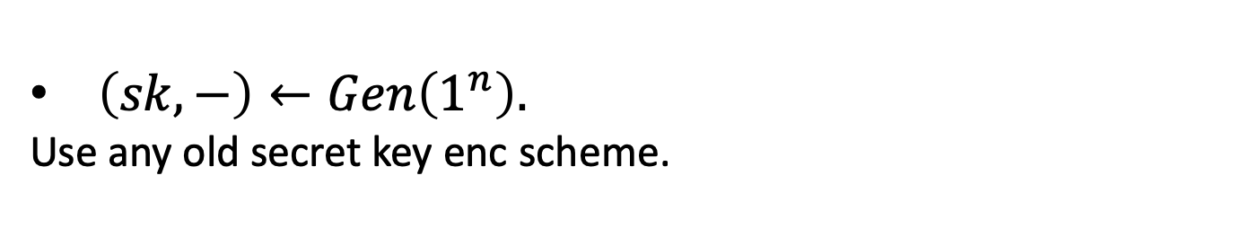
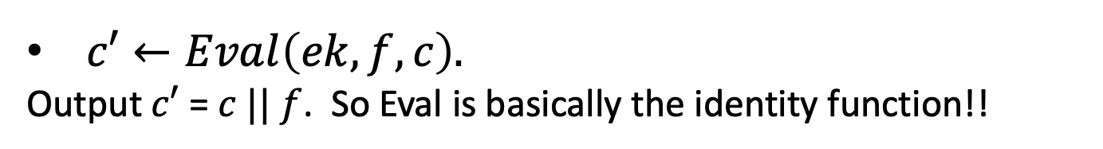
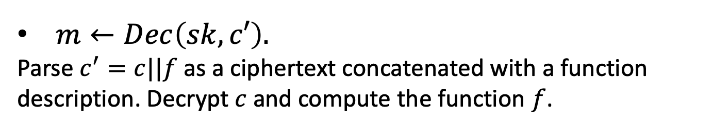

Here is a homomorphic encryption scheme…
$\left(sk,−\right)←Gen\left(1^{n}\right).$
Use any old secret key enc scheme.
$c←Enc\left(sk,m\right).$
Just the secret key encryption algorithm…
$c′←Eval\left(ek,f,c\right).$
Output $c′$ = $c || f$. So Eval is basically the identity function!!
$m←Dec\left(sk,c′\right).$
Parse $c^{′}=c||f$ as a ciphertext concatenated with a function description. Decrypt $c$ and compute the function $f$.
This is correct and it is IND-secure.

Slide 9
Homomorphic Encryption: Compactness
The size (bit-length) of the evaluated ciphertext and the runtime of the decryption is independent of the complexity of the evaluated function.
A Relaxation: The size (bit-length) of the evaluated ciphertext and the runtime of the decryption depends sublinearly on the complexity of the evaluated function.

Slide 10
Big Picture: Two Steps to FHE
Leveled Secret-key Homomorphic Encryption:
Evaluate circuits of a-priori bounded depth d
“you give me a depth bound d, I will give you a homomorphic scheme that handles depth-d circuits…”
Bootstrapping Theorem:
From “circular secure” Leveled FHE to Pure FHE (at the cost of an additional assumption)
“I will give you homomorphic scheme that handles circuits of ANY size/depth”
Notes:
n is a security parameter

Slide 11

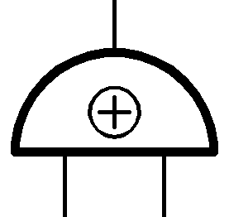
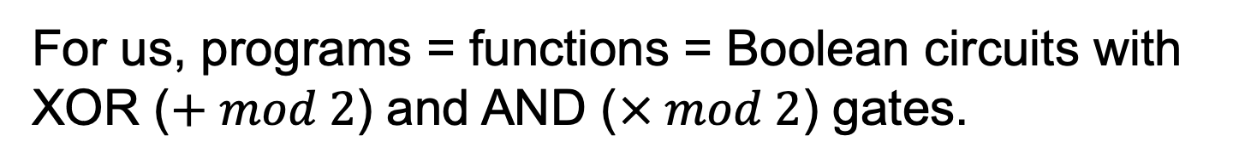
How to Compute Arbitrary Functions
For us, programs = functions = Boolean circuits with XOR ($+ mod 2$) and AND ($× mod 2$) gates.
$$Enc({(x_{1}+x_{2})x}_{3}x_{4})$$
X
$$Enc(x_{1}+x_{2})$$
$$Enc(x_{3}x_{4})$$
X
+
$$Enc(x_{3})$$
$$Enc(x_{4})$$
$$Enc(x_{2})$$
$$Enc(x_{1})$$
Takeaway: If you can compute XOR and AND on encrypted bits, you can compute everything.

Slide 12

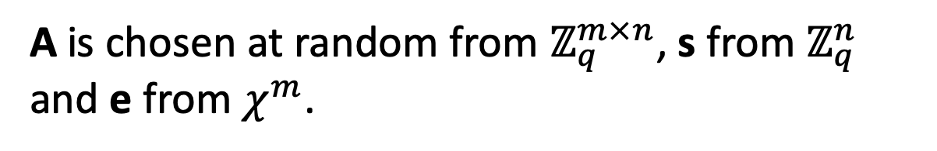
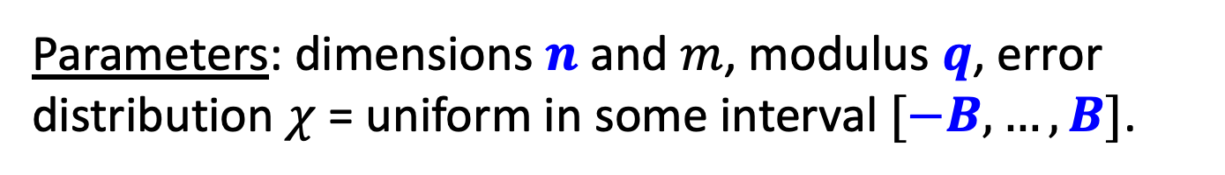
Learning with Errors (LWE)
s
Given:
A
and
A
+
e
GOAL: Find s.
Parameters: dimensions $n$ and $m$, modulus $q$, error distribution $χ$ = uniform in some interval $[−B,…,B]$.
A is chosen at random from $ℤ_{q}^{m×n}$, s from $ℤ_{q}^{n}$ and e from $χ^{m}$.

Slide 13

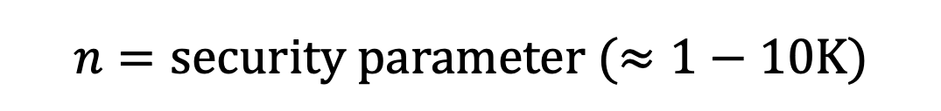
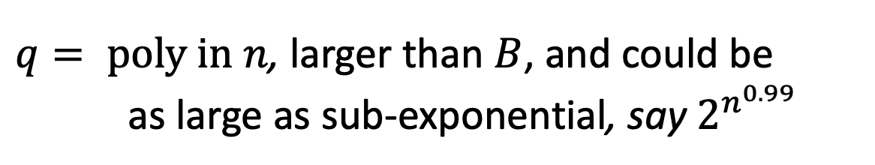


Setting Parameters
Put together, we are safe with:
$$n=security parameter (≈1−10K)$$
$$m=arbitrary poly in n$$
$$B=small poly in n, say \sqrt{n}$$
$q= poly in n$, larger than $B$, and could be
as large as sub-exponential, say $2^{n^{0.99}}$
even from quantum computers, AFAWK!

Slide 14
Decisional LWE
Can you distinguish between:
s
and
A
,
A
e
+
,
A
b
Theorem: “Decisional LWE is as hard as LWE”.

Slide 15
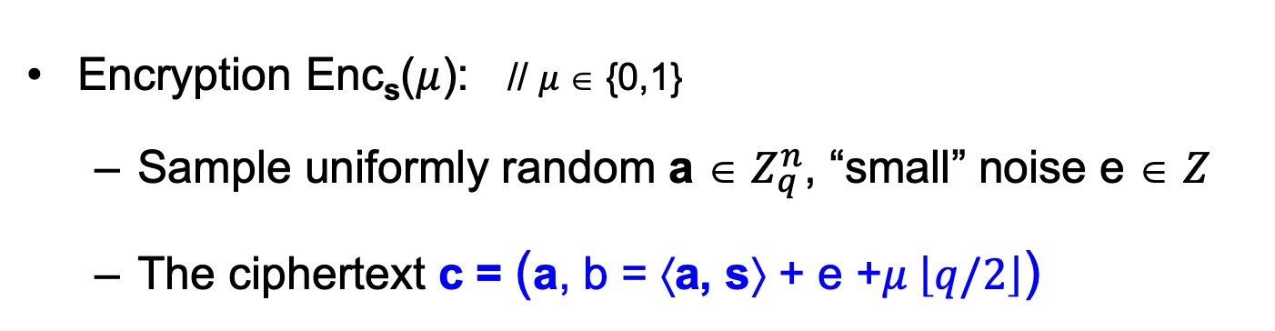
Basic (Secret-key) Encryption
[Regev05]
n = security parameter, q = “small” modulus
Secret key sk = Uniformly random vector s ∈ $Z_{q}^{n}$
Encryption Enc_{s}($μ$): // $μ$∈ {0,1}
  Sample uniformly random a ∈ $Z_{q}^{n}$, “small” noise e ∈ $Z$
  The ciphertext c = (a, b = ⟨a, s⟩ + e +$μ \left\lfloor q/2\right\rfloor$)
Decryption Dec_{sk}(c): Output Round_{q/2}(b − ⟨a, s⟩ mod q)
// correctness as long as |e| < q/4
Notes:
First iteration is incorrect because you only recover e+m upon decrypting
Solution: “error correct” or “make sure that m is a large number compared to e”

Slide 16

New (Secret-key) Encryption: Take 1
Private key: a vector s ${∈Z}_{q}^{n}$
Private-key Encryption of a bit $m∈\{0,1\}$:
  C = $\left[\begin{matrix}A \\ sA\end{matrix}\right]+m I$
($A$is random (n+1) X n matrix)
Decryption:
[s || -1] C = m [s || -1] (mod q)
= Eigenvector
Ciphertext matrix
Message
= Eigenvalue
Priv key
🙁 INSECURE! Easy to solve linear equations.

Slide 17
New (Secret-key) Encryption: Take 1
t . C = m . t (mod q)
t = [s || -1]
Homomorphic addition: C₁ + C₂
t is an eigenvector of C₁+C₂ with eigenvalue m₁+m₂
Homomorphic multiplication: C₁C₂
t is an eigenvector of C₁C₂ with eigenvalue m₁m₂
Proof: t . C₁ C₂ = (m₁ . t) . C₂ = m₁ . m₂ . t
But, remember, the scheme is insecure?
Key idea: fix insecurity while retaining homomorphism.

Slide 18


New (Secret-key) Encryption: Take 2
Private key: a vector s ${∈Z}_{q}^{n}$
Private-key Encryption of a bit $m∈\{0,1\}$:
  C = $\left[\begin{matrix}A \\ sA+e\end{matrix}\right]+m I$
($A$is random (n+1) X n matrix)
Decryption:
[s || -1] C ≈ m [s || -1] (mod q)
Priv key
Ciphertext matrix
Message
= Approx Eigenvalue
= Approx Eigenvector
🙂 CPA-secure by LWE.

Slide 19

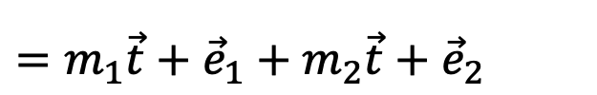

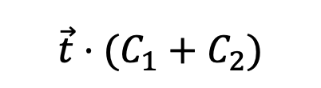
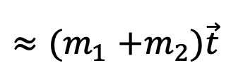
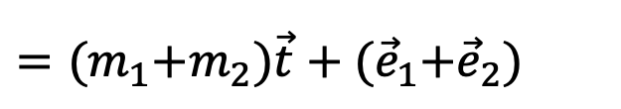
New (Secret-key) Encryption: Take 2
t . C = m . t + e (mod q)
t = [s || -1]
Homomorphic addition: C₁ + C₂
$${\vec{t}⋅(C}_{1}+C_{2})$$
$$={\vec{t}C}_{1}+{\vec{t}C}_{2}$$
$=m_{1}\vec{t}+{\vec{e}}_{1}+m_{2}\vec{t}+{\vec{e}}_{2}$
Noise grows a little
$={(m}_{1}+m_{2})\vec{t}+{(\vec{e}}_{1}+{\vec{e}}_{2})$
$${≈(m}_{1}+m_{2})\vec{t}$$

Slide 20
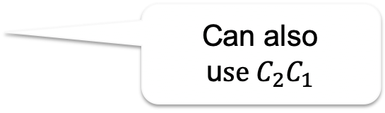
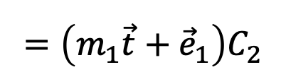
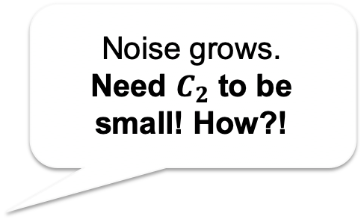
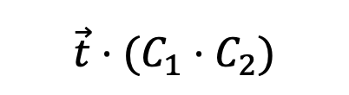

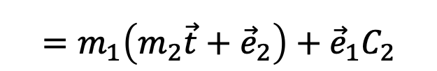


New (Secret-key) Encryption: Take 2
t . C = m . t + e (mod q)
t = [s || -1]
Homomorphic multiplication: C₁ C₂
Can also u$se C_{2}C_{1}$
$${\vec{t}⋅(C}_{1}⋅C_{2})$$
$$=\left(m_{1}\vec{t}+{\vec{e}}_{1}\right)C_{2}$$
Noise grows.
Need $C_{2}$ to be small! How?!
$$=m_{1}{\vec{t}C}_{2}+{\vec{e}}_{1}C_{2}$$
$$=m_{1}\left(m_{2}\vec{t}+{\vec{e}}_{2}\right)+{\vec{e}}_{1}C_{2}$$
$$=m_{1}m_{2}\vec{t}+m_{1}{\vec{e}}_{2}+{\vec{e}}_{1}C_{2}$$
$${\vec{e}}_{mult}$$

Slide 21
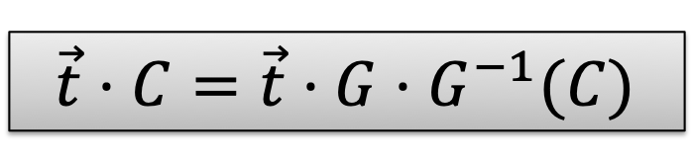
Aside: Binary Decomposition
Break each entry in $C$ into its binary representation
$bits\left(C\right)=\left[\begin{matrix}\begin{matrix}0 \\ 1 \\ 1\end{matrix} & \begin{matrix}1 \\ 0 \\ 1\end{matrix} \\ \begin{matrix}0 \\ 0 \\ 1\end{matrix} & \begin{matrix}1 \\ 0 \\ 0\end{matrix}\end{matrix}\right] (mod 8)$
$$C=\left[\begin{matrix}3 & 5 \\ 1 & 4\end{matrix}\right] (mod 8)$$
⇒
Small entries like we wanted!
Consider the “reverse” operation:
$$k\log{q}$$
$$\left[\begin{matrix}4 2 1 & 0 0 0 \\ 0 0 0 & 4 2 1\end{matrix}\right]⋅bits\left(C\right)=C$$
⇒
$$\vec{t}⋅C=\vec{t}⋅G⋅G^{−1}(C)$$
$$k$$
$$G$$
Denote: $G^{−1}\left(C\right)$ which has “small” entries

Slide 22


New (Secret-key) Encryption: Take 3
Private key: a vector s ${∈Z}_{q}^{n}$
Private-key Encryption of a bit $m∈\{0,1\}$:
  C = $\left[\begin{matrix}A \\ sA+e\end{matrix}\right]+m G$
($A$is random (n+1) X n log q matrix)
Decryption:
[s || -1] C ≈ m [s || -1] G (mod q)
Priv key
Ciphertext matrix
Message
= Approx “Eigenvalue”
= Approx Eigenvector
🙂 Still CPA-secure by LWE.

Slide 23

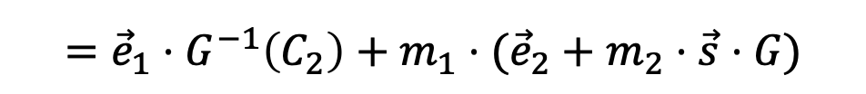
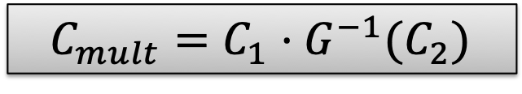



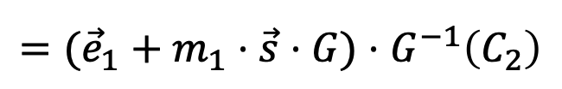
New (Secret-key) Encryption: Take 3
t . C = m . t . G + e (mod q)
t = [s || -1]
$$C_{mult}=C_{1}⋅G^{−1}(C_{2})$$
Homomorphic multiplication:
$$\vec{s}⋅C_{1}⋅G^{−1}\left(C_{2}\right)$$
$$=({\vec{e}}_{1}+m_{1}⋅\vec{s}⋅G)⋅G^{−1}\left(C_{2}\right)$$
$$={\vec{e}}_{1}⋅G^{−1}\left(C_{2}\right)+m_{1}⋅\vec{s}⋅G⋅G^{−1}\left(C_{2}\right)$$
$$={\vec{e}}_{1}⋅G^{−1}\left(C_{2}\right)+m_{1}⋅\vec{s}⋅C_{2}$$
$$={\vec{e}}_{1}⋅G^{−1}\left(C_{2}\right)+m_{1}⋅({\vec{e}}_{2}+m_{2}⋅\vec{s}⋅G)$$
$$=\left({\vec{e}}_{1}⋅G^{−1}\left(C_{2}\right)+m_{1}⋅{\vec{e}}_{2}\right)+m_{1}m_{2}⋅\vec{s}⋅G$$
$${\vec{e}}_{mult}$$
$$\left\|{\vec{e}}_{mult}\right\|≤n log q⋅\left\|{\vec{e}}_{1}\right\|+m_{1}⋅\left\|{\vec{e}}_{2}\right\|≤\left(n log q+1\right)⋅\max{\{\left\|{\vec{e}}_{1}\right\|,\left\|{\vec{e}}_{2}\right\|\}}$$

Slide 24
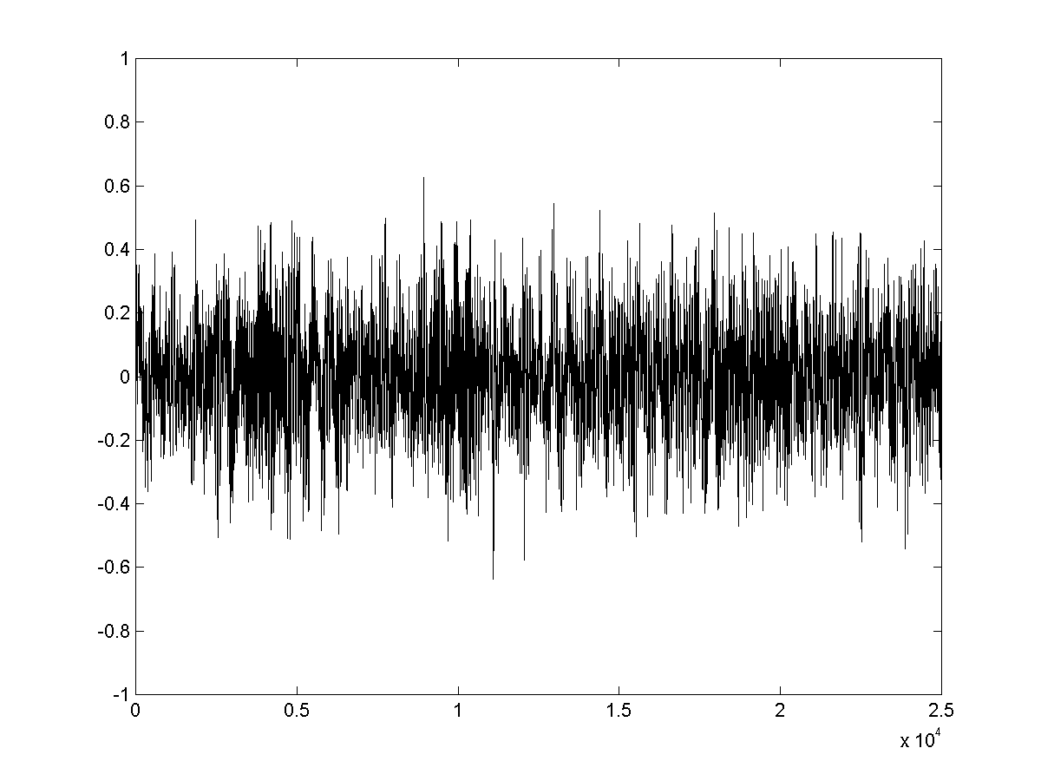

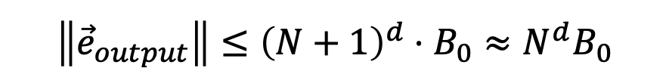


Homomorphic Circuit Evaluation
$$Let N=n log q$$
Noise grows during homomorphic eval
Depth $d$
$${\vec{e}}_{output}$$
$$\left\|{\vec{e}}_{output}\right\|≤{\left(N+1\right)}^{d}⋅B_{0}≈N^{d}B_{0}$$
⇒ Decryptable if $q≫N^{d}B_{0}$.
(for security: $q≪2^{n}$)
So this can support $d≈n^{0.99}$
…
$$\left\|{\vec{e}}_{i+1}\right\|≤(N+1)\left\|{\vec{e}}_{i}\right\|$$
$$\left\|{\vec{e}}_{input}\right\|≤B_{0}$$
$${\vec{e}}_{input}$$

Slide 25
Big Picture: Two Steps to FHE
Leveled Secret-key Homomorphic Encryption:
Evaluate circuits of a-priori bounded depth d
“you give me a depth bound d, I will give you a homomorphic scheme that handles depth-d circuits…”
Bootstrapping Theorem:
From “circular secure” Leveled FHE to Pure FHE (at the cost of an additional assumption)
“I will give you homomorphic scheme that handles circuits of ANY size/depth”
Notes:
n is a security parameter

Slide 26

From Leveled to Fully Homomorphic
Input: x
Function: f
Enc(sk,x)
$$x$$
Client
Server (the Cloud)
The cloud keeps homomorphically computing, but after a certain depth, the ciphertext is too noisy to be useful. What to do?
Idea: “Bootstrapping”!

Slide 27
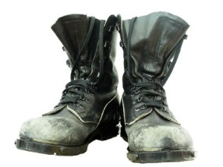

Bootstrapping: How
But the evaluator/cloud
does not have SK!
“Best Possible” Noise Reduction
= Decryption!
m
“Noiseless ciphertext”
$$Dec(∙,CT)$$
“Very Noisy” ciphertext
SK
Decryption Circuit

Slide 28
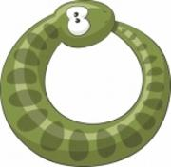

Bootstrapping, Concretely
Next Best
= Homomorphic Decryption!
*
Assume server knows ek = Enc_{SK}(SK).
(OK assuming the scheme is “circular secure”)
Enc_{SK}(m)
$$Dec(∙,CT)$$
Enc_{SK}(SK)

Slide 29
Bootstrapping, Concretely
Next Best
= Homomorphic Decryption!
B_{dec} Independent of B_{input}
*
Assume server knows ek = Enc_{SK}(SK).
(OK assuming the scheme is “circular secure”)
Enc_{SK}(m)
Noise = B_{dec}
$$Dec(∙,CT)$$
Noise = B_{input}
Enc_{SK}(SK)

Slide 30
Wrap Up: Bootstrapping
Assume Circular Security:
Function f
Evaluation key is Enc_{SK}(SK)
g

Slide 31


Wrap Up: Bootstrapping
Assume Circular Security:
Function f
Evaluation key is Enc_{SK}(SK)
g
Each Gate g → Gadget G:
g(a,b)
g
g(a,b)
a
b
g
$$Dec(∙,c_{a})$$
$$Dec(∙,c_{b})$$
a
b
sk
sk

Slide 32
Wrap Up: Bootstrapping
Assume Circular Security:
Function f
Evaluation key is Enc_{SK}(SK)
g
Each Gate g → Gadget G:
Enc(g(a,b))
g
g(a,b)
a
b
g
$$Dec(∙,c_{a})$$
$$Dec(∙,c_{b})$$
a
b
Enc(sk)
Enc(sk)

Slide 33
Wrap Up: Bootstrapping
Bootstrapping Theorem [Gen09] (Quantitative)
circular-secure d-HE with dec. depth < d ⇒ FHE
publish Enc_{PK}(SK)
d-HE with decryption depth < d ⇒ (leveled) FHE
publish Enc_{PK2}(SK1), Enc_{PK3}(SK2),…, Enc_{PKd}(SK_{d-1})
Notes:
Very general theorem, independent of which enc scheme you use

Slide 34
How about Function Privacy?
Input: x
Function: f
Enc(sk,x)
$$x$$
Enc(f(x))
Client
Server (the Cloud)
Security against the curious cloud = standard IND-security of secret-key encryption
Security against a curious user?

Slide 35
Function Privacy
Input: x
Function: f
Enc(sk,x)
$$x$$
Enc(f(x))
Client
Server (the Cloud)
Function Privacy: Enc(f(x)) reveals no more information (about f) than f(x).

Slide 36
HOMOMORPHIC ENCRYPTION IN PRACTICE
DARPA $60M investment [2012-17].
Many Open Source Libraries.
PALISADE
SEAL
HELib
HEEAN

Slide 37




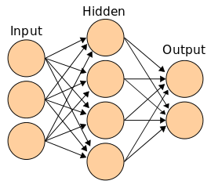
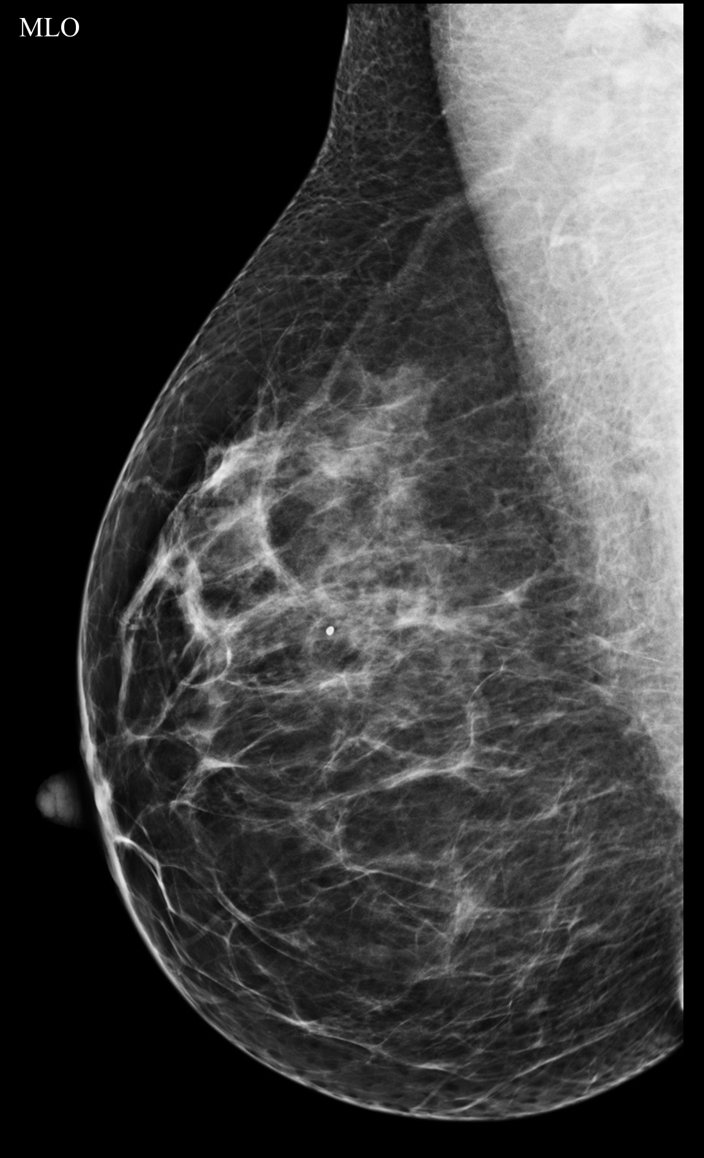



APPLICATIONS of HOMOMORPHIC ENCRYPTION
Healthcare
Financial
Medical Imaging
Applying genomic analysis
to 1K patients
13 seconds
Benchmarking cyberrisk on 1M
records
12 seconds
Breast density detection on encrypted mammograms
60 seconds
1
Winner of the 2018 iDash International Homomorphic Encryption competition
Collaboration with Dana Farber and Duality Technologies.
Collaboration with Andrew Lo@Sloan and Danny Weitzner@CSAIL Internet Policy Research Initiative.
Collaboration with Regina Barzilay@CSAIL and Anantha Chandrakasan@EECS.
Synergy of Algorithms & Data Science & HPC & Crypto

Slide 38



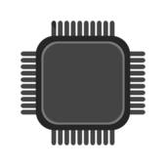
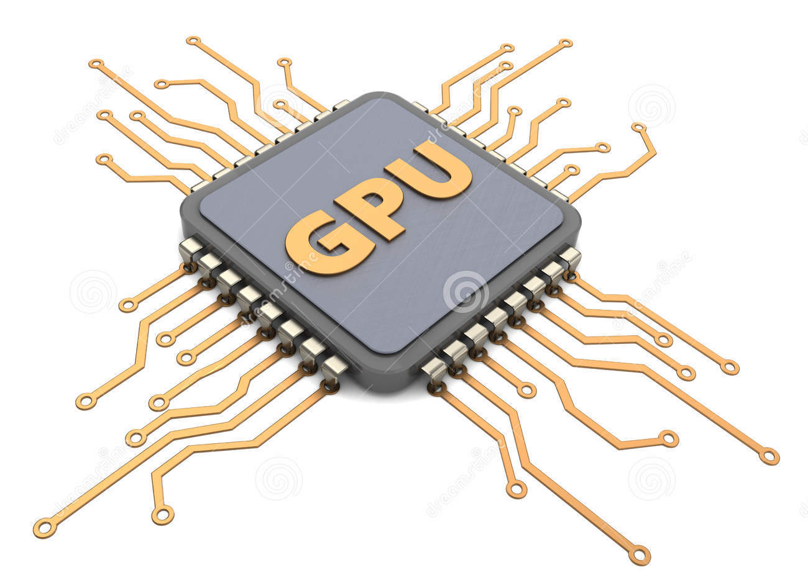
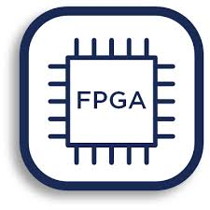
THE DREAM
Data Science Platforms
Homomorphic
ML Algorithms
Homomorphic
Linear Algebra Layer
Homomorphic STACK
Homomorphic
Instruction Set
Many Secure Computing Startups.
Standardization Efforts.
homomorphicencryption.org

Slide 39
Next Lecture:
Homomorphic Encryption and Database Lookup

