Slide 1
MIT 6.875 & Berkeley CS276
Foundations of Cryptography
Lecture 3

Slide 2
Roadmap of the Course: Worlds in Crypto
…
Cryptomania:
Lecture 7-10,…
Public-key encryption
Minicrypt:
Zero-Knowledge proofs
Lecture 2-6, 11-12
PRP
Digital Signatures
Bit Commitment
PRF
Secret-key encryption
PRG
Hashing
OWF
OWF

Slide 3
Today
1. Define one-way functions (OWF).
2. Define Hardcore bits (HCB).
3. Show that one-way functions* + HCB $⇒$ PRG
4. Goldreich-Levin Theorem: every OWF has a HCB.

Slide 4
One-way Functions (Informally)
F
Easy to
compute
Hard to
invert
domain
range

Slide 5
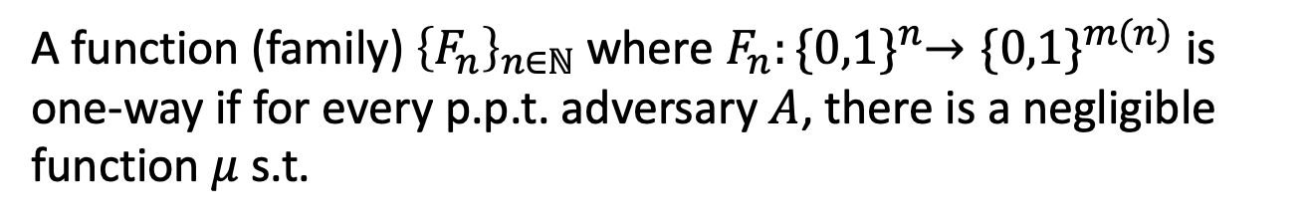
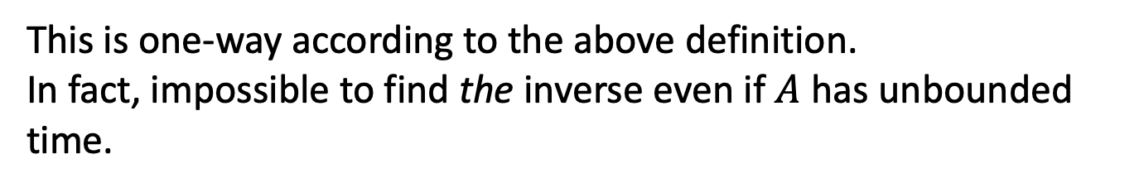
One-way Functions (Take 1)
A function (family${\text{) }\left\{F_{n}\right\}}_{n∈ℕ}$ where $F_{n}:{\{0,1\}}^{n}→{\{0,1\}}^{m(n)}$ is one-way if for every p.p.t. adversary $A$, there is a negligible function $μ$ s.t.
$$\operatorname{Pr}\left[x←{\left\{0,1\right\}}^{n};y=F_{n}\left(x\right):A\left(1^{n},y\right)=x\right]≤μ(n)$$
Consider $F_{n}\left(x\right)=0$ for all x.
This is one-way according to the above definition.
In fact, impossible to find the inverse even if $A$ has unbounded time.
Conclusion: not a useful/meaningful definition.

Slide 6
One-way Functions (Take 1)
A function (family${\text{) }\left\{F_{n}\right\}}_{n∈ℕ}$ where $F_{n}:{\{0,1\}}^{n}→{\{0,1\}}^{m(n)}$ is one-way if for every p.p.t. adversary $A$, there is a negligible function $μ$ s.t.
$$\operatorname{Pr}\left[x←{\left\{0,1\right\}}^{n};y=F_{n}\left(x\right):A\left(1^{n},y\right)=x\right]≤μ(n)$$
The Right Definition: Impossible to find an inverse in p.p.t.

Slide 7
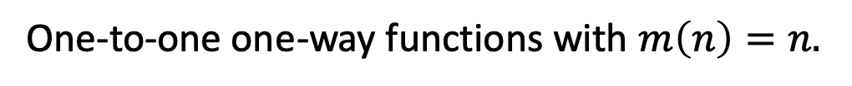
One-way Functions: The Definition
A function (family${\text{) }\left\{F_{n}\right\}}_{n∈ℕ}$ where $F_{n}:{\{0,1\}}^{n}→{\{0,1\}}^{m(n)}$ is one-way if for every p.p.t. adversary $A$, there is a negligible function $μ$ s.t.
$$\operatorname{Pr}\left[x←{\left\{0,1\right\}}^{n};y=F_{n}\left(x\right);A\left(1^{n},y\right)=x^{′}:y=F_{n}\left(x^{′}\right)\right]≤μ(n)$$
Can always find an inverse with unbounded time
… but should be hard with probabilistic polynomial time
One-way Permutations:
One-to-one one-way functions with $m\left(n\right)=n.$

Slide 8
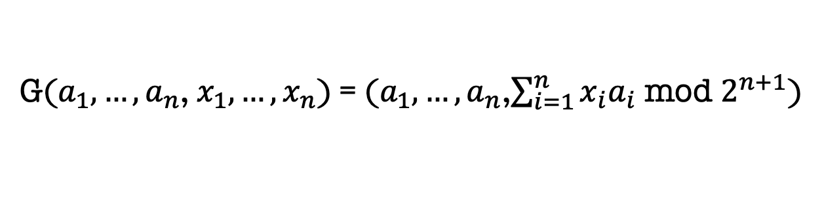
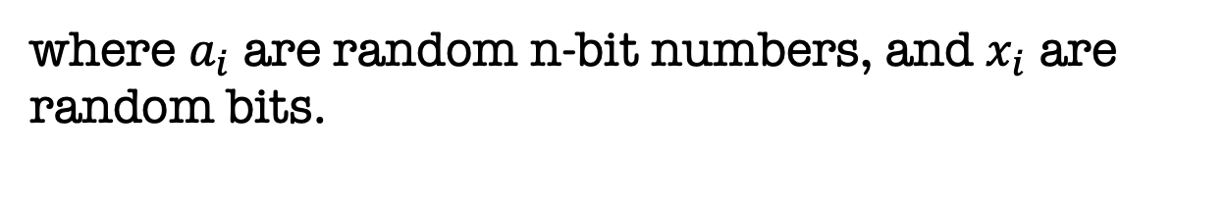
One-way Functions: Candidates
Subset sum:
G($a_{1},…,a_{n}$, $x_{1},…,x_{n}$) = ($a_{1},…,a_{n}$,$\sum_{i=1}^{n}{x_{i}a_{i}}$ mod $2^{n+1}$)
where $a_{i}$ are random n-bit numbers, and $x_{i}$ are random bits.
One-way functions candidates are abundant in nature.
We will see many other candidates from number theory, coding theory, combinatorics later in class.

Slide 9
Today
1. Define one-way functions (OWF).
2. Define Hardcore bits (HCB).
3. Show that one-way permutations (OWP) $⇒$ PRG
4. Goldreich-Levin Theorem: every OWF has a HCB.

Slide 10
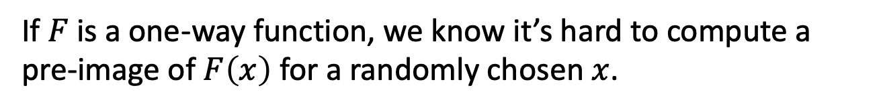
Hardcore Bits
If $F$ is a one-way function, we know it’s hard to compute a pre-image of $F\left(x\right)$ for a randomly chosen $x$.
How about computing partial information about an inverse?
Exercise: There are one-way functions for which it is easy to compute the first half of the bits of the inverse.
Notes:
Poll: F(xy) = F(x) || y is it one-way?

Slide 11
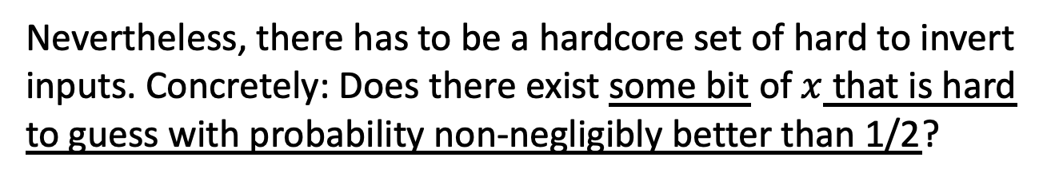
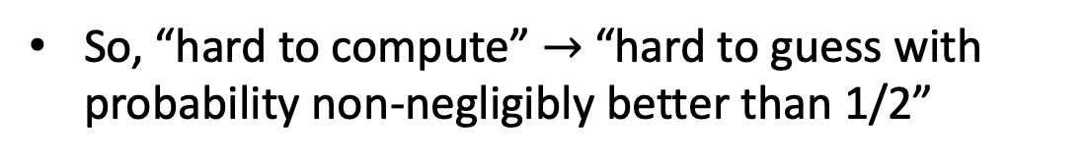
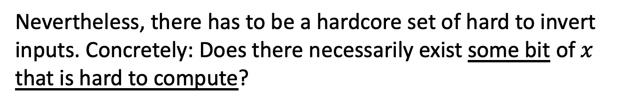
Hardcore Bits
If $F$ is a one-way function, we know it’s hard to compute a pre-image of $F\left(x\right)$ for a randomly chosen $x$.
HARDCORE BIT (Take 1)
Nevertheless, there has to be a hardcore set of hard to invert inputs. Concretely: Does there exist some bit of $x$ that is hard to guess with probability non-negligibly better than 1/2?
Nevertheless, there has to be a hardcore set of hard to invert inputs. Concretely: Does there necessarily exist some bit of $x$ that is hard to compute?
Any bit can be guessed correctly w.p. 1/2
So, “hard to compute” $→$ “hard to guess with probability non-negligibly better than 1/2”

Slide 12
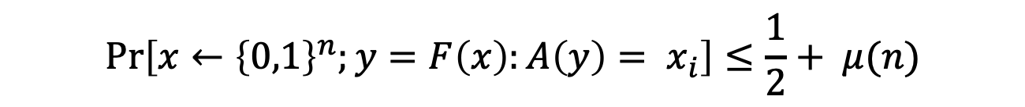
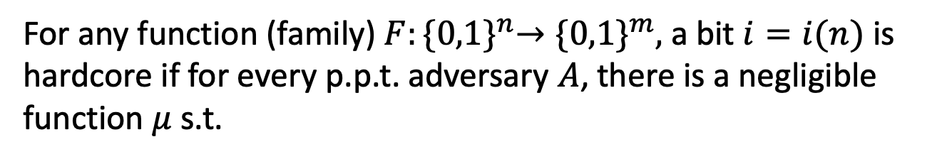
Hardcore Bits
If $F$ is a one-way function, we know it’s hard to compute a pre-image of $F\left(x\right)$ for a randomly chosen $x$.
HARDCORE BIT (Take 1)
For any function (family) $F:{\{0,1\}}^{n}→{\{0,1\}}^{m},$ a bit $i=i(n)$ is hardcore if for every p.p.t. adversary $A$, there is a negligible function $μ$ s.t.
$$\operatorname{Pr}\left[x←{\left\{0,1\right\}}^{n};y=F\left(x\right):A\left(y\right)= x_{i}\right]≤\frac{1}{2}+ μ(n)$$

Slide 13
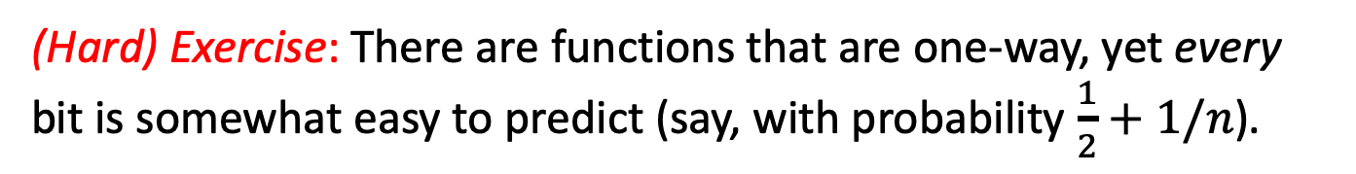
Does every one-way function
have a hardcore bit?
(Hard) Exercise: There are functions that are one-way, yet every bit is somewhat easy to predict (say, with probability $\frac{1}{2}+1/n$).
So, we will generalize the notion of a hardcore “bit”.

Slide 14
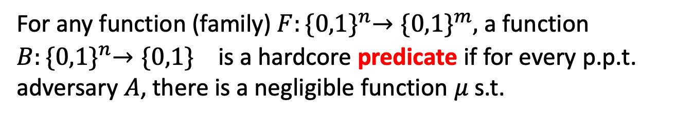
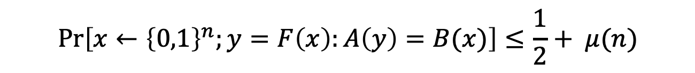
Hardcore Bits
HARDCORE PREDICATE (Definition)
For any function (family) $F:{\{0,1\}}^{n}→{\{0,1\}}^{m},$ a function $B:{\{0,1\}}^{n}→{\{0,1\}}^{}$ is a hardcore predicate if for every p.p.t. adversary $A$, there is a negligible function $μ$ s.t.
$$\operatorname{Pr}\left[x←{\left\{0,1\right\}}^{n};y=F\left(x\right):A\left(y\right)=B(x)\right]≤\frac{1}{2}+ μ(n)$$
For us, henceforth, a hardcore bit will mean a hardcore predicate.

Slide 15
Hardcore Predicate (in pictures)
Easy to
compute
F(x)
Hard to
compute
x
B(x)
Easy to
compute

Slide 16
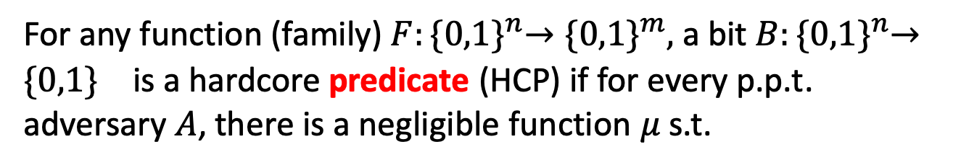
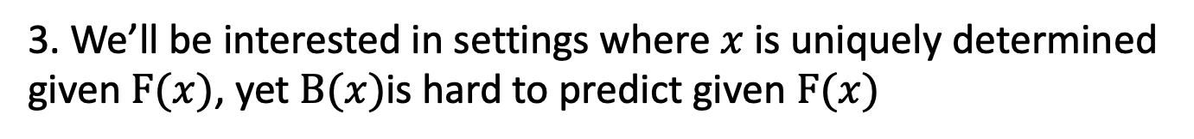
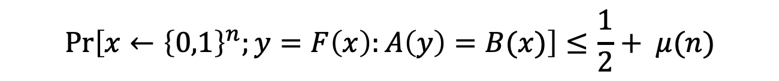
Discussion on the Definition
HARDCORE PREDICATE (Definition)
For any function (family) $F:{\{0,1\}}^{n}→{\{0,1\}}^{m},$ a bit $B:{\{0,1\}}^{n}→{\{0,1\}}^{}$ is a hardcore predicate (HCP) if for every p.p.t. adversary $A$, there is a negligible function $μ$ s.t.
$$\operatorname{Pr}\left[x←{\left\{0,1\right\}}^{n};y=F\left(x\right):A\left(y\right)=B(x)\right]≤\frac{1}{2}+ μ(n)$$
1. Definition of HCP makes sense for any function family, not just one-way functions.
2. Some functions can have information-theoretically hard to guess predicates (e.g., compressing functions)
3. We’ll be interested in settings where $x$ is uniquely determined given $F(x)$, yet $B(x)$is hard to predict given $F(x)$

Slide 17
Today
1. Define one-way functions (OWF).
2. Define Hardcore bits (HCB).
3. Show that one-way permutations (OWP) $⇒$ PRG
4. Goldreich-Levin Theorem: every OWF has a HCB.

Slide 18

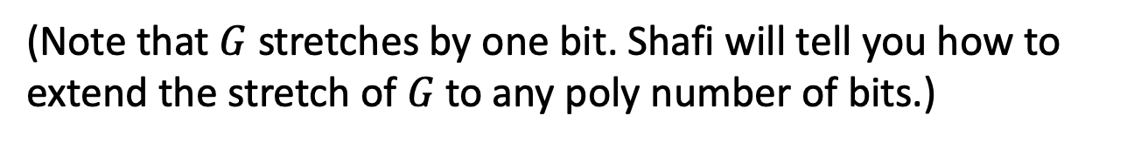
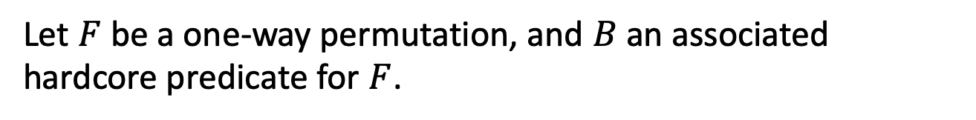
OWP $⇒$ PRG
CONSTRUCTION
Let $F$ be a one-way permutation, and $B$ an associated hardcore predicate for $F$.
Then, define $G\left(x\right)=F\left(x\right) | B(x)$ .
Theorem: $G$ is a PRG assuming $F$ is a one-way permutation.
(Note that $G$ stretches by one bit. Shafi will tell you how to extend the stretch of $G$ to any poly number of bits.)

Slide 19
OWP $⇒$ PRG
CONSTRUCTION
Let $F$ be a one-way permutation, and $B$ an associated hardcore predicate for $F$.
Then, define $G\left(x\right)=F\left(x\right) | B(x)$ .
Theorem: $G$ is a PRG assuming $F$ is a one-way permutation.
Proof (next slide): From Distinguishing to Predicting.

Slide 20
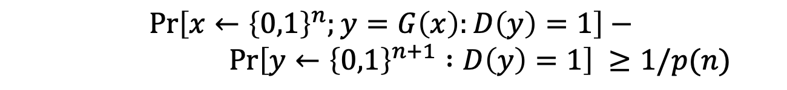
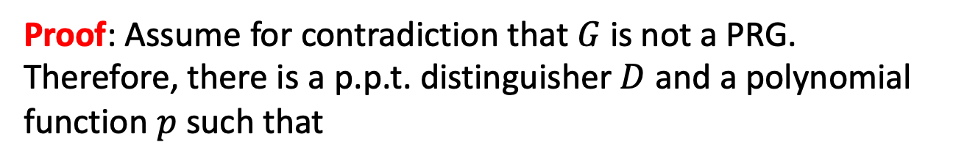
OWP $⇒$ PRG
Theorem: $G$ is a PRG assuming $F$ is a one-way permutation.
Proof: Assume for contradiction that $G$ is not a PRG. Therefore, there is a p.p.t. distinguisher $D$ and a polynomial function $p$such that
$$\operatorname{Pr}\left[x←{\left\{0,1\right\}}^{n};y=G\left(x\right):D\left(y\right)=1\right]−$$
$$\operatorname{Pr}\left[y←{\left\{0,1\right\}}^{n+1} :D\left(y\right)=1\right] ≥1/p(n)$$
Think: D outputs “1” $=$ D thinks its input is pseudorandom

Slide 21

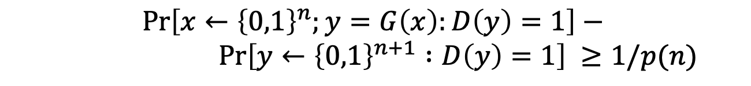
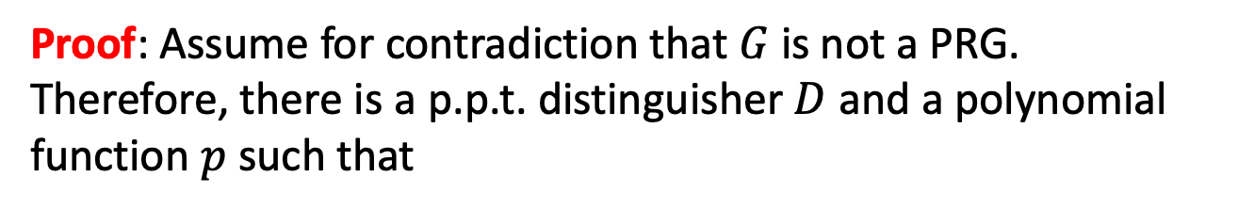
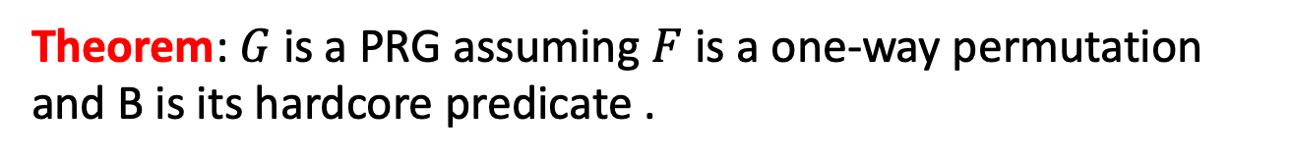
OWP $⇒$ PRG
Theorem: $G$ is a PRG assuming $F$ is a one-way permutation and B is its hardcore predicate .
Proof: Assume for contradiction that $G$ is not a PRG. Therefore, there is a p.p.t. distinguisher $D$ and a polynomial function $p$such that
$$\operatorname{Pr}\left[x←{\left\{0,1\right\}}^{n};y=G\left(x\right):D\left(y\right)=1\right]−$$
$$\operatorname{Pr}\left[y←{\left\{0,1\right\}}^{n+1} :D\left(y\right)=1\right] ≥1/p(n)$$
We will construct a hardcore predictor $A$ and show:
$$\operatorname{Pr}\left[x←{\left\{0,1\right\}}^{n}:A\left(F(x)\right)=B(x)\right]≥\frac{1}{2}+1/p′(n)$$

Slide 22
OWP $⇒$ PRG
Theorem: $G$ is a PRG assuming $F$ is a one-way permutation and B is its hardcore predicate .
Proof: Assume for contradiction that $G$ is not a PRG. Therefore, there is a p.p.t. distinguisher $D$ and a polynomial function $p$such that
$$\operatorname{Pr}\left[x←{\left\{0,1\right\}}^{n};y=G\left(x\right):D\left(y\right)=1\right]−$$
$$\operatorname{Pr}\left[y←{\left\{0,1\right\}}^{n+1} :D\left(y\right)=1\right] ≥1/p(n)$$
We will construct a hardcore predictor $A$ and show:
$$\operatorname{Pr}\left[x←{\left\{0,1\right\}}^{n}:A\left(F(x)\right)=B(x)\right]≥\frac{1}{2}+1/p′(n)$$

Slide 23
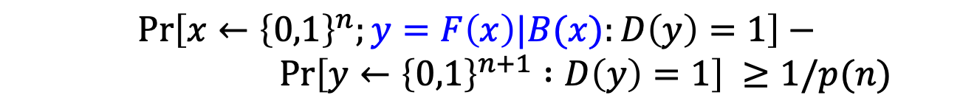
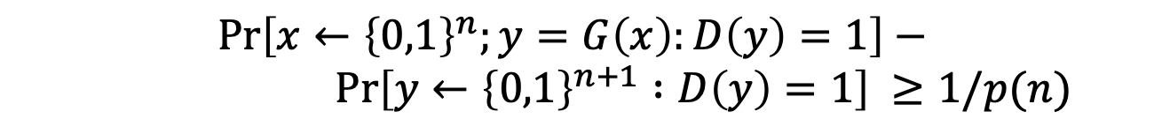
OWP $⇒$ PRG
Let’s look closely at D.
$$\operatorname{Pr}\left[x←{\left\{0,1\right\}}^{n};y=G\left(x\right):D\left(y\right)=1\right]−$$
$$\operatorname{Pr}\left[y←{\left\{0,1\right\}}^{n+1} :D\left(y\right)=1\right] ≥1/p(n)$$
By definition:
$$\operatorname{Pr}\left[x←{\left\{0,1\right\}}^{n};y=F\left(x\right)|B(x):D\left(y\right)=1\right]−$$
$$\operatorname{Pr}\left[y←{\left\{0,1\right\}}^{n+1} :D\left(y\right)=1\right] ≥1/p(n)$$

Slide 24
OWP $⇒$ PRG
Let’s look closely at D.
$$\operatorname{Pr}\left[x←{\left\{0,1\right\}}^{n};y=G\left(x\right):D\left(y\right)=1\right]−$$
$$\operatorname{Pr}\left[y←{\left\{0,1\right\}}^{n+1} :D\left(y\right)=1\right] ≥1/p(n)$$
A syntactic change:
$$\operatorname{Pr}\left[x←{\left\{0,1\right\}}^{n};y=F\left(x\right)|B(x):D\left(y\right)=1\right]−$$
$$\operatorname{Pr}\left[y_{0}←{\left\{0,1\right\}}^{n} ,y_{1}←\left\{0,1\right\}, y=y_{0}|y_{1}:D(y)=1\right] ≥1/p(n)$$

Slide 25

OWP $⇒$ PRG
Let’s look closely at D.
$$\operatorname{Pr}\left[x←{\left\{0,1\right\}}^{n};y=G\left(x\right):D\left(y\right)=1\right]−$$
$$\operatorname{Pr}\left[y←{\left\{0,1\right\}}^{n+1} :D\left(y\right)=1\right] ≥1/p(n)$$
Rewriting the second term:
$$\operatorname{Pr}\left[x←{\left\{0,1\right\}}^{n};y=F\left(x\right)|B(x):D\left(y\right)=1\right]−$$
$$\operatorname{Pr}\left[x←{\left\{0,1\right\}}^{n} ,y_{1}←\left\{0,1\right\}, y=F(x)|y_{1}:D(y)=1\right] ≥1/p(n)$$
$$=$$
$$\frac{\operatorname{Pr}\left[x←{\left\{0,1\right\}}^{n} , y=F(x)|0:D(y)=1\right]+ \operatorname{Pr}\left[x←{\left\{0,1\right\}}^{n} , y=F(x)|1:D(y)=1\right] }{2}$$

Slide 26
OWP $⇒$ PRG
Let’s look closely at D.
$$\operatorname{Pr}\left[x←{\left\{0,1\right\}}^{n};y=G\left(x\right):D\left(y\right)=1\right]−$$
$$\operatorname{Pr}\left[y←{\left\{0,1\right\}}^{n+1} :D\left(y\right)=1\right] ≥1/p(n)$$
Rewriting the second term (again):
$$\operatorname{Pr}\left[x←{\left\{0,1\right\}}^{n};y=F\left(x\right)|B(x):D\left(y\right)=1\right]−$$
$$\operatorname{Pr}\left[x←{\left\{0,1\right\}}^{n} ,y_{1}←\left\{0,1\right\}, y=F(x)|y_{1}:D(y)=1\right] ≥1/p(n)$$
$$=$$
$$\frac{\operatorname{Pr}\left[x←{\left\{0,1\right\}}^{n} , y=F(x)|B(x):D(y)=1\right]+ \operatorname{Pr}\left[x←{\left\{0,1\right\}}^{n} , y=F(x)|\overline{B(x)}:D(y)=1\right] }{2}$$

Slide 27
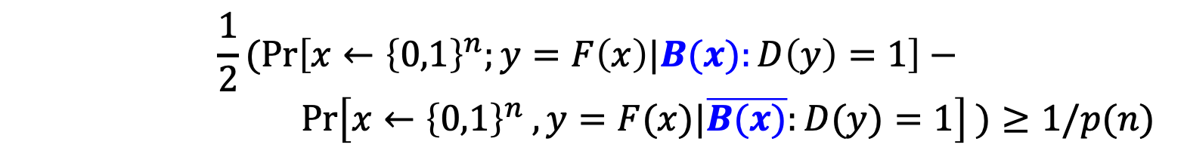
OWP $⇒$ PRG
Let’s look closely at D.
$$\operatorname{Pr}\left[x←{\left\{0,1\right\}}^{n};y=G\left(x\right):D\left(y\right)=1\right]−$$
$$\operatorname{Pr}\left[y←{\left\{0,1\right\}}^{n+1} :D\left(y\right)=1\right] ≥1/p(n)$$
Putting things together:
$$\frac{1}{2}(\operatorname{Pr}\left[x←{\left\{0,1\right\}}^{n};y=F\left(x\right)|B(x):D\left(y\right)=1\right]−$$
$$\operatorname{Pr}\left[x←{\left\{0,1\right\}}^{n} , y=F(x)|\overline{B(x)}:D(y)=1\right] )≥1/p(n)$$
In English: D says “1” more often when fed with the “right bit” than the “wrong bit”.

Slide 28

OWP $⇒$ PRG
Let’s look closely at D.
$$\operatorname{Pr}\left[x←{\left\{0,1\right\}}^{n};y=G\left(x\right):D\left(y\right)=1\right]−$$
$$\operatorname{Pr}\left[y←{\left\{0,1\right\}}^{n+1} :D\left(y\right)=1\right] ≥1/p(n)$$
Putting things together:
$$\frac{1}{2}(\operatorname{Pr}\left[x←{\left\{0,1\right\}}^{n};y=F\left(x\right)|B(x):D\left(y\right)=1\right]−$$
$$\operatorname{Pr}\left[x←{\left\{0,1\right\}}^{n} , y=F(x)|\overline{B(x)}:D(y)=1\right] )≥1/p(n)$$
$$(∗)$$
Now, let’s use D to predict the right bit.

Slide 29
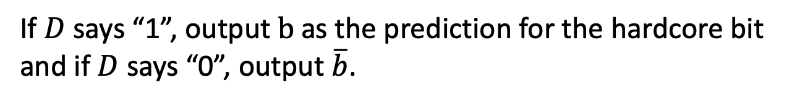
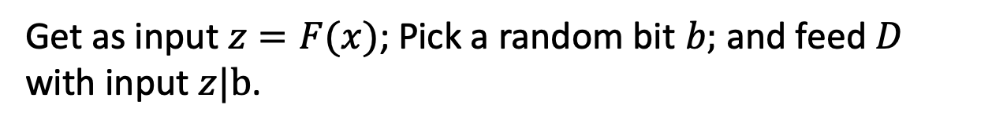
OWP $⇒$ PRG
The Predictor A works as follows:
Get as input $z=F(x)$; Pick a random bit $b;$and feed $D$ with input $z|b$.
If $D$ says “1”, output $b$ as the prediction for the hardcore bit and if $D$ says “0”, output $\overline{b}$.

Slide 30
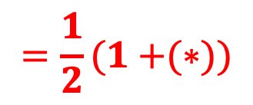



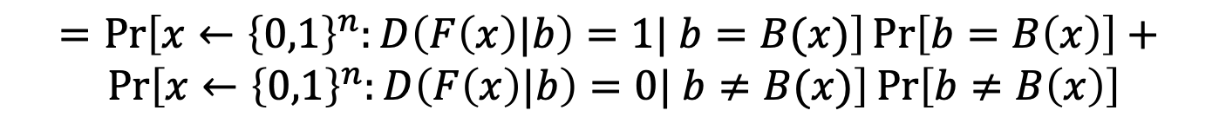
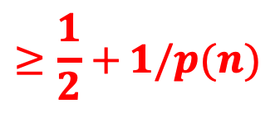
Analysis of the Predictor A
$$\operatorname{Pr}\left[x←{\left\{0,1\right\}}^{n}:A\left(F(x)\right)=B(x)\right]$$
$$=\operatorname{Pr}\left[x←{\left\{0,1\right\}}^{n}:D\left(F\left(x\right)|b\right)=1| b=B(x)\right]\operatorname{Pr}\left[b=B\left(x\right)\right]+$$
$$Pr⁡\left[x←{\left\{0,1\right\}}^{n}:D\left(F\left(x\right)|b\right)=0| b≠B(x)\right]\operatorname{Pr}\left[b≠B\left(x\right)\right]$$
$$=\frac{1}{2}(Pr\left[x←{\left\{0,1\right\}}^{n}:D\left(F\left(x\right)|b\right)=1| b=B(x)\right]+$$
$$Pr⁡\left[x←{\left\{0,1\right\}}^{n}:D\left(F\left(x\right)|b\right)=0| b≠B(x)\right])$$
$$=\frac{1}{2}(Pr\left[x←{\left\{0,1\right\}}^{n}:D\left(F\left(x\right)|B(x)\right)=1\right]+$$
$$Pr⁡\left[x←{\left\{0,1\right\}}^{n}:D\left(F\left(x\right)|\overline{B(x)}\right)=0\right])$$
$$=\frac{1}{2}(Pr\left[x←{\left\{0,1\right\}}^{n}:D\left(F\left(x\right)|B(x)\right)=1\right]+$$
$$1−Pr⁡\left[x←{\left\{0,1\right\}}^{n}:D\left(F\left(x\right)|\overline{B(x)}\right)=1\right])$$
$$=\frac{1}{2}(1+{(∗)})$$
$$≥\frac{1}{2}+{1/p(n)}$$
Notes:
By def of how D works
Since b is random
Syntactic
Since pr[D(..)=0] = 1 – pr[D(..) = 1]

Slide 31
Today
1. Define one-way functions (OWF).
2. Define Hardcore bits (HCB).
3. Show that one-way permutations (OWP) $⇒$ PRG
4. Goldreich-Levin Theorem: every OWF has a HCB.

Slide 32
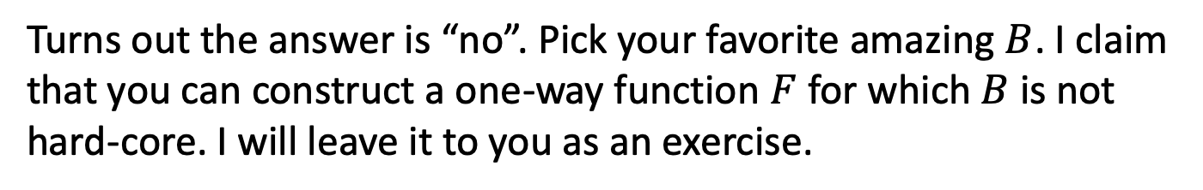
A Hardcore Predicate for all OWF
Let’s shoot for a universal hardcore predicate.
i.e., a single predicate $B$ where it is hard to guess $B(x)$ given $F(x)$
Is this possible?
Turns out the answer is “no”. Pick your favorite amazing $B$. I claim that you can construct a one-way function $F$ for which $B$ is not hard-core. I will leave it to you as an exercise.
So, what is one to do?

Slide 33
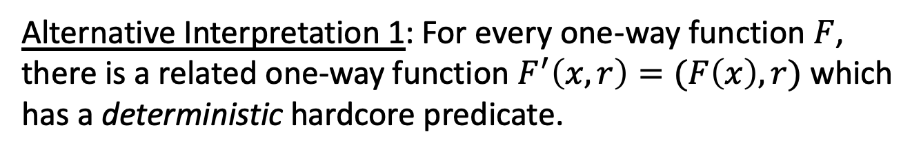
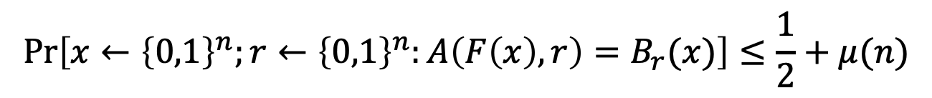
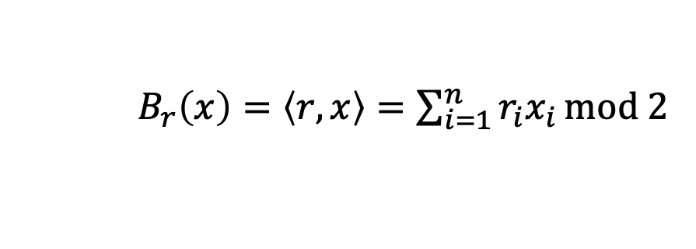
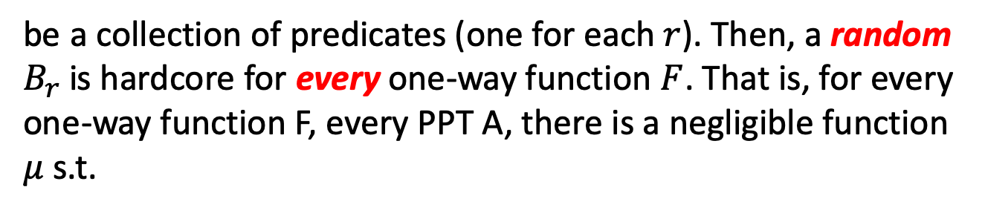
Goldreich-Levin (GL) Theorem
Let ${\{B}_{r}:{\{0,1\}}^{n}→\{0,1\}\}$ where
$B_{r}\left(x\right)=\left\langle r,x\right\rangle =\sum_{i=1}^{n}{r_{i}x_{i}}mod 2$
be a collection of predicates (one for each $r$). Then, a random $B_{r}$is hardcore for every one-way function $F$. That is, for every one-way function F, every PPT A, there is a negligible function $μ$ s.t.
$$\operatorname{Pr}\left[x←{\left\{0,1\right\}}^{n};r←{\left\{0,1\right\}}^{n}:A\left(F\left(x\right),r\right)=B_{r}(x)\right]≤\frac{1}{2}+μ(n)$$
Alternative Interpretation 1: For every one-way function $F$, there is a related one-way function $F^{′}\left(x,r\right)=(F\left(x\right),r)$ which has a deterministic hardcore predicate.

Slide 34
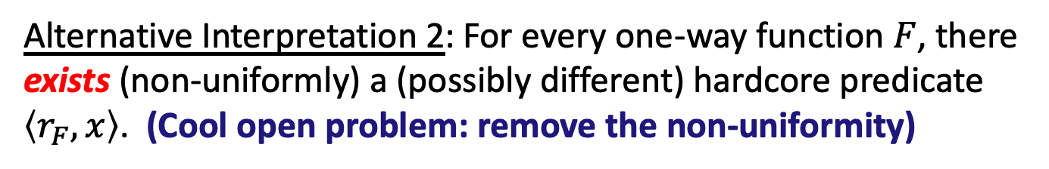
Goldreich-Levin (GL) Theorem
Let ${\{B}_{r}:{\{0,1\}}^{n}→\{0,1\}\}$ where
$B_{r}\left(x\right)=\left\langle r,x\right\rangle =\sum_{i=1}^{n}{r_{i}x_{i}}mod 2$
be a collection of predicates (one for each $r$). Then, a random $B_{r}$is hardcore for every one-way function $F$. That is, for every one-way function F, every PPT A, there is a negligible function $μ$ s.t.
$$\operatorname{Pr}\left[x←{\left\{0,1\right\}}^{n};r←{\left\{0,1\right\}}^{n}:A\left(F\left(x\right),r\right)=B_{r}(x)\right]≤\frac{1}{2}+μ(n)$$
Alternative Interpretation 2: For every one-way function $F$, there exists (non-uniformly) a (possibly different) hardcore predicate $\left\langle r_{F},x\right\rangle$. (Cool open problem: remove the non-uniformity)

Slide 35
Proof of GL Theorem
Let’s make our lives easier: assume a perfect predictor $P$
Assume for contradiction there is a predictor $P$
$$\operatorname{Pr}\left[x←{\left\{0,1\right\}}^{n};r←{\left\{0,1\right\}}^{n}:P\left(F\left(x\right),r\right)=\left\langle r,x\right\rangle \right]≥\frac{1}{2}+1/p(n)$$
$$\operatorname{Pr}\left[x←{\left\{0,1\right\}}^{n};r←{\left\{0,1\right\}}^{n}:P\left(F\left(x\right),r\right)=\left\langle r,x\right\rangle \right]=1$$
We will need to show an inverter $A$ for $F$
$$\operatorname{Pr}\left[x←{\left\{0,1\right\}}^{n} :A\left(F\left(x\right)\right)=x^{′}:F\left(x^{′}\right)=F(x)\right]≥1/p′(n)$$

Slide 36
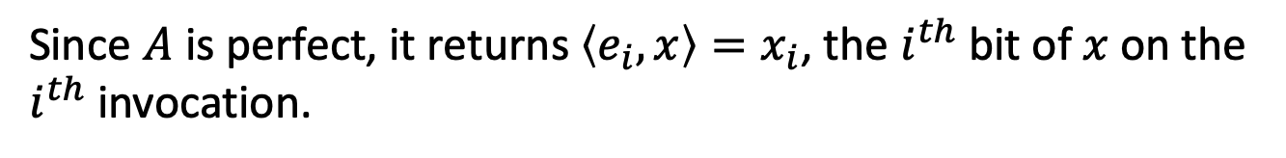
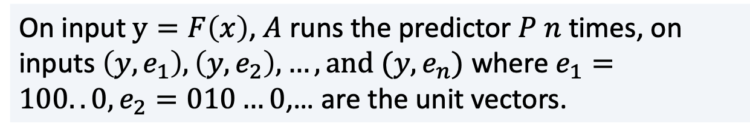
Proof of GL Theorem
Let’s make our lives easier: assume a perfect predictor $P$
Assume for contradiction there is a predictor $P$
$$\operatorname{Pr}\left[x←{\left\{0,1\right\}}^{n};r←{\left\{0,1\right\}}^{n}:P\left(F\left(x\right),r\right)=\left\langle r,x\right\rangle \right]=1$$
The inverter $A$ works as follows:
On input $y=F\left(x\right)$, $A$ runs the predictor $P$ $n$ times, on inputs $\left(y,e_{1}\right), \left(y,e_{2}\right),…, and (y,e_{n})$ where $e_{1}=100..0, e_{2}=010…0$,… are the unit vectors.
Since $A$ is perfect, it returns $\left\langle e_{i},x\right\rangle =x_{i}$, the $i^{th}$ bit of $x$ on the $i^{th}$ invocation.

Slide 37
Proof of GL Theorem
OK, now let’s assume less: assume a pretty good predictor $P$
Assume for contradiction there is a predictor $P$
$$\operatorname{Pr}\left[x←{\left\{0,1\right\}}^{n};r←{\left\{0,1\right\}}^{n}:P\left(F\left(x\right),r\right)=\left\langle r,x\right\rangle \right]≥\frac{3}{4}+1/p(n)$$
First, we need an averaging argument.
Claim: For at least a $1/2p(n)$ fraction of the $x$,
$$\operatorname{Pr}\left[r←{\left\{0,1\right\}}^{n}:P\left(F\left(x\right),r\right)=\left\langle r,x\right\rangle \right]≥\frac{3}{4}+1/2p(n)$$
Proof: Exercise in counting.
Call these the good $x.$

Slide 38
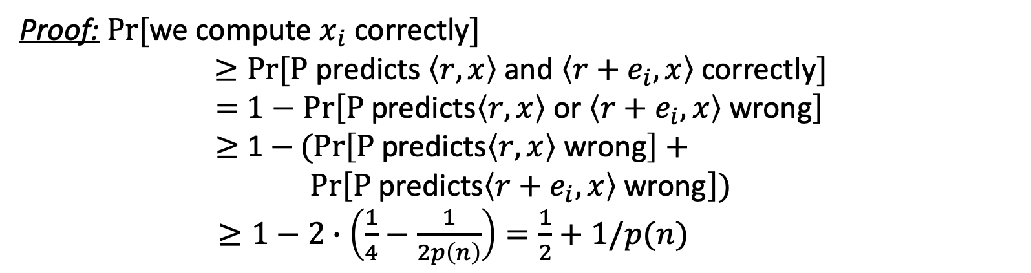
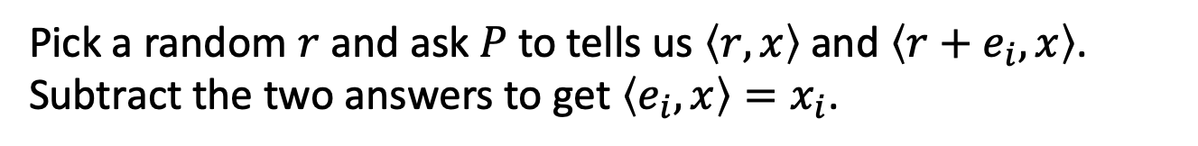
Proof of GL Theorem
For at least a $1/2p(n)$ fraction of the $x$,
$$\operatorname{Pr}\left[r←{\left\{0,1\right\}}^{n}:P\left(F\left(x\right),r\right)=\left\langle r,x\right\rangle \right]≥\frac{3}{4}+1/2p(n)$$
Key Idea: Linearity
Pick a random $r$ and ask $P$ to tells us $\left\langle r,x\right\rangle$ and $\left\langle r+e_{i},x\right\rangle$. Subtract the two answers to get $\left\langle e_{i},x\right\rangle =x_{i}$.
Proof: $Pr⁡[$we compute $x_{i}$ correctly$]$
$$≥Pr⁡[\text{P} \text{predicts} \left\langle r,x\right\rangle \text{and} \left\langle r+e_{i},x\right\rangle \text{correctly}]$$
$=$ $1−\operatorname{Pr}\left[\text{P} \text{predicts}\left\langle r,x\right\rangle \text{or} \left\langle r+e_{i},x\right\rangle \text{wrong}\right]$
$≥$ 1 $−(Pr\left[\text{P} \text{predicts}\left\langle r,x\right\rangle \text{wrong}\right]+$
$$\operatorname{Pr}\left[\text{P} \text{predicts}\left\langle r+e_{i},x\right\rangle \text{wrong}\right])$$
$≥1−2∙\left(\frac{1}{4}−\frac{1}{2p\left(n\right)}\right)=\frac{1}{2}+1/p(n)$
(by union bound)

Slide 39
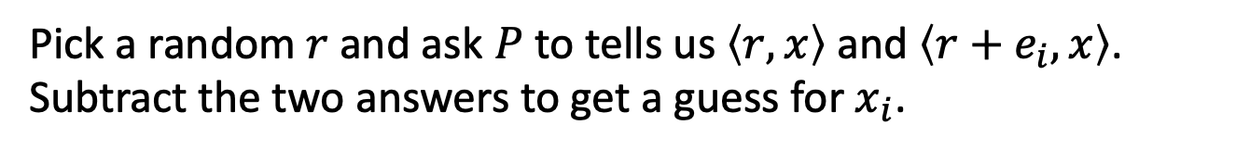
Proof of GL Theorem
For at least a $1/2p(n)$ fraction of the $x$,
$$\operatorname{Pr}\left[r←{\left\{0,1\right\}}^{n}:P\left(F\left(x\right),r\right)=\left\langle r,x\right\rangle \right]≥\frac{3}{4}+1/2p(n)$$
Inverter A:
Repeat for each $i∈\left\{1,2,…,n\right\}$:
Repeat $\log{n}/p(n)$ times:
Pick a random $r$ and ask $P$ to tells us $\left\langle r,x\right\rangle$ and $\left\langle r+e_{i},x\right\rangle$. Subtract the two answers to get a guess for $x_{i}$.
Compute the majority of all such guesses and set the bit as $x_{i}$
Output the concatenation of all $x_{i}$ as $x.$
Analysis: Chernoff + Union Bound

Slide 40
Real Proof (will not do in class)
Assume (after averaging) that for $≥1/2p(n)$ fraction of the $x$,
$$\operatorname{Pr}\left[r←{\left\{0,1\right\}}^{n}:P\left(F\left(x\right),r\right)=\left\langle r,x\right\rangle \right]≥\frac{1}{2}+1/2p(n)$$
Key Idea: Pairwise independence
Reference: Goldreich Book Part 1, Section 2.5.2.
http://www.wisdom.weizmann.ac.il/~oded/PSBookFrag/part2N.ps

Slide 41
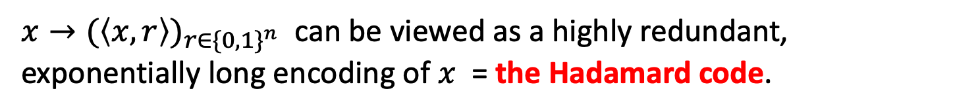
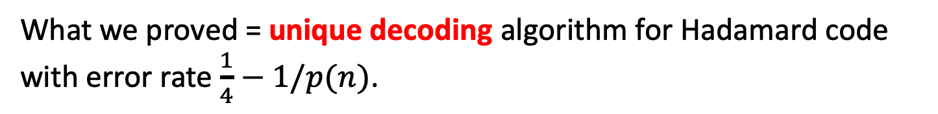
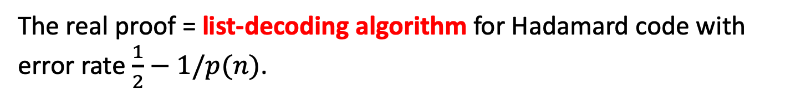
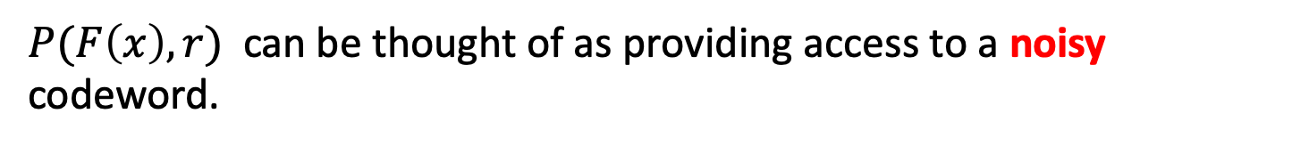
The Coding-Theoretic View of GL
$x→{(\left\langle x,r\right\rangle )}_{r∈{\{0,1\}}^{n}}$ can be viewed as a highly redundant, exponentially long encoding of $x$ = the Hadamard code.
$P(F\left(x\right),r)$ can be thought of as providing access to a noisy codeword.
What we proved = unique decoding algorithm for Hadamard code with error rate $\frac{1}{4}−1/p(n)$.
The real proof = list-decoding algorithm for Hadamard code with error rate $\frac{1}{2}−1/p(n)$.

Slide 42
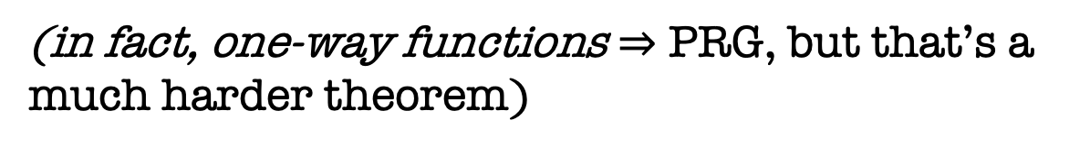
Recap
1. Defined one-way functions (OWF).
2. Defined Hardcore bits (HCB).
3. Goldreich-Levin Theorem: every OWF has a HCB.
(showed proof for an important special case)
4. Show that one-way permutations (OWP) $⇒$ PRG
(in fact, one-way functions $⇒$ PRG, but that’s a much harder theorem)

Slide 43
Next Lecture: Back to PRGs

